Slide 1

Python OOP
Course Introduction
SoftUni Team
Technical Trainers
Software University
https://about.softuni.bg/

Slide 2
Table of Contents
Partners
Course Objectives
Training and Team
Course Organization
Course Infrastructure
Evaluation Criteria
2

Slide 3
Have a Question?
sli.do
#python-advanced

Slide 4










SoftUni Diamond Partners

Slide 5



Educational Partners

Slide 6

Course Objectives

Slide 7
Python OOP Objectives
Understand the OOP paradigm
Creating a hierarchy of classes and inheritance
SOLID Principles
Working with Iterators and Generators
Applying the OOP principles
Component testing
Working with decorators
Design Patterns
7

Slide 8
Practical Programming Exam
3 practical problems for 4 hours:
Create a simple project that
Follows the OOP principles
Implements functionality based on a description
Test a provided class
Automated judge system with real-time feedback
Upload a zip project to the judge system
8

Slide 9
Theoretical Exam
You will have 30 minutes once you enter
Multiple-choice with 1 correct answer
English
Automated quiz system
Available online the day of the practical exam
You can submit your answers just one time
9

Slide 10

Training and Team

Slide 11
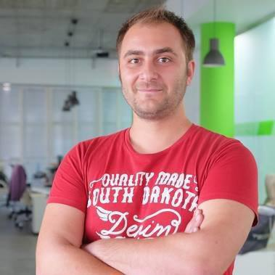
Doncho Minkov
Technical lead, Architect and DevOps at SoftUni
10+ years of experience as a Technical Trainer
Front-end developer by heart
Software developer by need
Experienced in Django, Node.js, .NET and others
Fluent in Python, JavaScript, C#, Java, C++
"30 under 30" – Forbes 2017 - Education

Slide 12
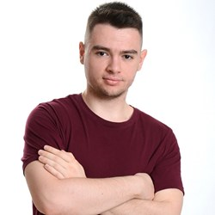
Atanas Atanasov
.NET Software Engineer at Fourth
End-to-End Restaurant and Hospitality Software
Working with .NET and JavaScript(Angular || React)
Technical Trainer @ SoftUni
100+ training sessions
Interested in the vast world of algorithms

Slide 13

Course Organization

Slide 14
Python OOP Course
25-Oct-2021
11-Dec-2021
20-Dec-2021
Python OOP
6 weeks * 4 times / week
15 credits
Start: 25-Oct-2021
Theoretical Exam: 11-Dec-2021
Final exam: 11-Dec-2021
Re-Take Exams
Theoretical Exam Retake: 20-Dec-2021
Final Exam Retake : 20-Dec-2021

Slide 15

Homework Assignments & Exercises
Your homework is mainly work in class
Lesson days → slides + live demos + exercises
Exercise days → only exercises
How to submit your homework?
Submitted in the judge system
Do your homework when it's due
Assignments pile up quickly

Slide 16


SoftUni Certificate
Practical Exam 100%
Homework 5%
Evaluation
16

Slide 17
CPE Certificate
Practical Exam
Theoretical Exam
Evaluation
17

Slide 18


Course Web Site, Forum and FB Group
Official web site:
Softuni Python Community group:
https://softuni.bg/courses/python-oop
https://www.facebook.com/groups/SoftUniPythonCommunity

Slide 19
Questions?
Notes:
19

Slide 20
Trainings @ Software University (SoftUni)
Software University – High-Quality Education, Profession and Job for Software Developers
softuni.bg, about.softuni.bg
Software University Foundation
softuni.foundation
Software University @ Facebook
facebook.com/SoftwareUniversity
Software University Forums
forum.softuni.bg
20
Notes:
20

Slide 21

License
This course (slides, examples, demos, exercises, homework, documents, videos and other assets) is copyrighted content
Unauthorized copy, reproduction or use is illegal
© SoftUni – https://about.softuni.bg
© Software University – https://softuni.bg
Notes:
21

